Slide 1
Application-aware IPv6 Networking - APN6 Framework draft-li-6man-app-aware-ipv6-network-00 Zhenbin Li, Shuping Peng, Huawei Chongfeng Xie, Cong Li, China Telecom

Slide 2
Foundations for APN6 -
IPv6/SRv6 Benefits: Future-proof Programmability
IPv6 Extension Headers
SRv6 SRH: Three Levels of Programmable Space
Version | Traffic Class | Flow Label
Payload Length |  |  | Next=43 | Hop Limit
Source Address
Destination Address
Hop-by-Hop Options Header
Destination Options Header
Routing Header/SRH
……
Destination Options Header
Payload
IP Header
SRv6 Segment Routing Header
TLV
Payload
128 bits
128 bits
128 bits
128 bits
IPv6 Header
SA
DA
Segment [0]
128bits
Segment [1]
Loc
Func
Args
2
1
…
x
y
z
SR Header
Segment [n]
Option TLV
3

Slide 3



Application-aware IPv6/SRv6 Networking (APN6)
Make use of IPv6 extensions header to convey the service requirements along with the packet to the network
To facilitate the service deployment and network resource adjustment to guarantee SLA for applications
SRv6 (Host-side Solution)
Video from Netflix/Youtube APP
/ Game from Tencent APP
IPv6 H
App Info is carried in the SID Argus or SRH TLV
IPv6 H
IPv6 H
IPv6 H
SID List
SID List
App Info is carried in the SID Argus or SRH TLV
SRv6 (Network-side Solution)
App Info is added into the IPv6 EXH
App Info is added into the IPv6 EXH
SRH TLV
SRH TLV
App Info
HBH
IPv6 H
IPv6 H
IPv6 H
IPv6 H
SLA
APP ID
User ID
App-aware Edge Device (DL)
Application Identification
Add ID/req. in the IPv6 EXH
HBH
APP Info
APP Info
APP Info
App Req. Para.
Video from Netflix/Youtube APP
/ Game from Tencent APP
SLA
APP ID
User ID
Steer into a SRv6 tunnel
Performance Guarantee
for applications
App-aware-process End-Point
Remove the service requirements of the APPs
App Req. Para.
App-aware-process Head-End
Match to the SR policy according to the application requirements
App-aware-process Mid-point
Service requirements guarantee
DC
App-aware Edge Device (UL)
Application Identification
Add ID/req. in the IPv6 EXH
Leaf
APP
Access
Aggregation
Leaf
APP
Multi VM VNF
APP
2B
CPE
ACC
AGG
ASBR
DC GW
Spine
Leaf
APP
APP
FBB
2C
RG
ACC
AGG
ASBR
DC GW
Spine
Leaf
APP
APP
MBB
Service-aware Apps
IPv6 enabled APP
Add ID/req. in the IPv6 EXH
Service-aware Apps
IPv6 enabled APP
Add ID/req. in the IPv6 EXH
https://tools.ietf.org/html/draft-li-6man-app-aware-ipv6-network-00 @IETF105

Slide 4
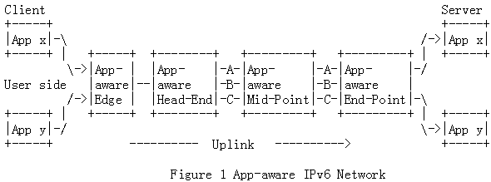
App-aware IPv6 Networking (APN6) Framework
APN6 is to make use of IPv6 Extension Headers
to convey the application related information including its requirements along with the packet to the network
to facilitate the service deployment and guarantee SLA
According to the carried App Info, steer the packets into an existing path/policy, or trigger to set up new
App Info is copied to the outer IPv6 extension header
According to the carried App Info, adjust the resources locally to guarantee SLA
Optionally add the app information (ID, service requirements) in an IPv6 extension header
Optionally add the app information (ID, service requirements) in an IPv6 extension header.
Derived from L2 QinQ Info

Slide 5
Application-aware Options
Application-aware ID option
Service-Para Option

Slide 6

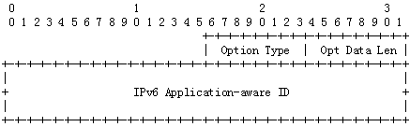


Application-aware ID Option
Carrying application ID, user ID, flow ID, and service requirements/SLAs
The length of the APP-aware ID depends on the locations
128bits = IPv6 address = SRv6 SID = A address
Structure I: Any combination of SLA level (e.g. Gold, Silver, Bronze), APP ID, and/or user ID, and/or Flow ID
Structure II: Any combination of SLA level (e.g. Gold, Silver, Bronze), APP ID, and/or user ID, and/or Flow ID, plus the arguments which indicating the service requirements of the identified application
Structure III: An SRv6 SID, with its arguments as the information specified in Structure II

Slide 7
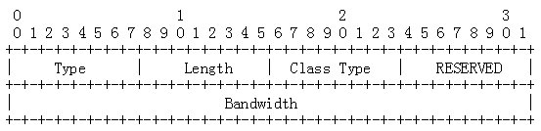
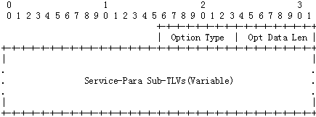

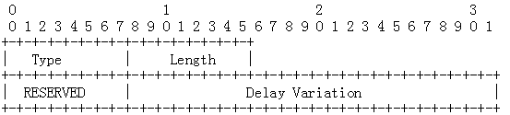
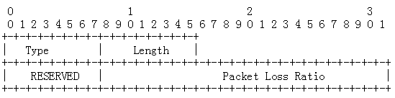
Service-Para Option
Carrying the service requirement parameter

Slide 8
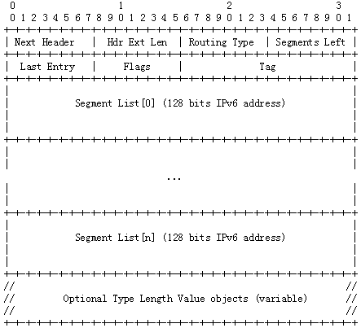
Locations for Application-aware Options
IPv6 Header
Hop-by-Hop Options header
Destination Options header
Routing header
Other headers
Upper-Layer header
IPv6 Header [RFC8200]
draft-ietf-6man-segment-routing-header

Slide 9
Use cases What we can do with the App-aware options?
Steer packets into SRv6 tunnels/Policy at the head-end
Steer packets into the path that can guarantee SLA at the mid-point
Filter packets at VAS devices along the SFC instead of using DPI and 5 tuples
Low latency
Head-end
End-Point
High bandwidth
High reliability
High SLA
Head-end
Mid-Point
End-Point
Low SLA
SF
Classifier
SFF1
SFF2

Slide 10
Thank you!

Slide 11
IPv6 Enhanced HBH Options Header
The App-aware options can be carried in the HBH header, but needs to be processed at wire speed to achieve high forwarding performance
However, [RFC8200] specifies that
nodes may be configured to ignore the Hop-by-Hop Options header (HBH)
the packets containing a HBH may be dropped
the packets containing a HBH may be assigned to a slow processing path, which will greatly reduce the forwarding performance
The App-aware options will not be properly processed according to the current specifications
Will it be solved only by configuration?
All the HBH options will be treated in the same way, however, they may have different processing requirements
https://www.ietf.org/archive/id/draft-ietf-6man-hbh-header-handling-03.txt
Every option needs to be checked one by one and decide how to process against the pre-configuration
Or by defining a new HBH header?
All the HBH options carried in this header will be processed at wire speed
This header can also be used to carry the path service instruction part
IPv6 Header
Hop-by-Hop Options header
Destination Options header
Routing header
Other headers
Upper-Layer header
IPv6 Header [RFC8200]

